Slide 1
Introduction to Angular
Sholpan Saimassayeva
s.saimassayeva@kbtu.kz

Slide 2
Agenda
Introduction to Angular
Goals and Architecture of Angular
Angular CLI usage
JavaScript vs. TypeScript basics

Slide 3
What is Angular?
Angular is a TypeScript-based open-source front-end framework developed by Google.
Used for building single-page applications (SPAs).
Provides a structured and modular approach to web development.

Slide 4
What is the Goal of Angular?
Angular is designed to streamline web development, enabling developers to build high-performance, scalable, and maintainable applications efficiently.

Slide 5
Key Goals
Scalability: Built for large teams and massive codebases.
Performance: Uses the Ivy Rendering Engine for fast execution and small bundle sizes.
Productivity: Provides a clear structure and opinionated "best practices" to avoid decision fatigue.
Cross-Platform: Can be used to build web, mobile, and desktop apps.

Slide 6
Angular Architecture
Modules
Components
Templates
Services
Directives & Pipes

Slide 7
Core Architectural Building Blocks
Angular follows a Component-Based Architecture.
Modules (NgModules): Containers for a block of code. Every app has at least one Root Module (AppModule)
Components: The fundamental building blocks of the UI. Each component consists of:
A Template (HTML).
A Class (TypeScript logic).
Styles (CSS).
3. Templates and Data Binding: Angular uses specialized syntax to link the logic TypeScript class to the HTML view.
4. Services: Classes used for sharing data or logic across multiple components

Slide 8
Objectives of Angular
Build Single-Page Applications
Angular is optimized for creating dynamic SPAs, where content updates without requiring full-page reloads, enhancing user experience.
Provide a Modular and Scalable Architecture
Uses a component-based architecture, making applications easier to develop, test, and scale. Encourages code reusability through modules, services, and dependency injection.

Slide 9
Objectives of Angular
Enhance Performance and Maintainability Features like lazy loading, ahead-of-time (AOT) compilation, and change detection optimizations improve speed and efficiency. TypeScript ensures better maintainability and reduces runtime errors.
Facilitate Cross-Platform Development
Angular supports web, mobile, and desktop applications (e.g., Angular Universal for server- side rendering and Ionic/NativeScript for mobile apps).

Slide 10
Objectives of Angular
Improve Developer Productivity
Provides built-in tools like Angular CLI for project setup, testing, and deployment. Offers two-way data binding, directives, and RxJS for handling complex UI interactions.

Slide 11
Key Features of Angular
Component-based Architecture
Two-way Data Binding
Dependency Injection (DI)
Directives
Routing
RxJS for Reactive Programming

Slide 12
TypeScript in Angular
TypeScript is a superset of JavaScript that adds static typing, interfaces, and advanced features.
Ensures better code maintainability.
Provides strong typing for catching errors early.
Supports object-oriented programming concepts.

Slide 13
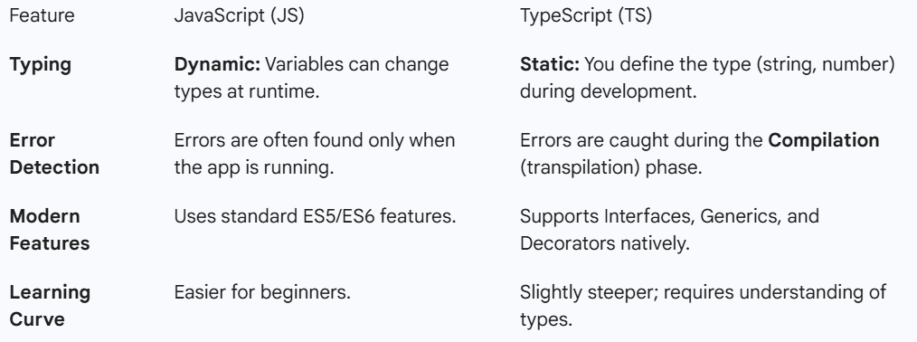
JavaScript vs Typescript

Slide 14
Setting Up an Angular Project
1. Install Node.js and npm
2. Install Angular CLI: 'npm install -g @angular/cli'
3. Create a new project: 'ng new my-angular-app'
4. Serve the application: 'ng serve'

Slide 15
Angular CLI - Key Commands
-ng new project-name
-ng serve
-ng generate component component-name
-ng build
-ng test

